Slide 1

物聯網應用設計實作
狗狗配件
第八組
10811212蔡承諭
10811220胡修銘
10811226陳冠霖

Slide 2


專題構想
需求定義
創意收斂
市上產品比較
專題架構圖
目錄
專題需求
周遭配件
感測器介紹
整體接線方式
程式碼介紹

Slide 3

專題構想

Slide 4
|需求定義
校狗定位
顯示溫度
狗狗受歡迎程度(紅外線+觸摸)
濕度95%判定為在水中
若在水中蜂鳴器讓搜尋者好發現

Slide 5
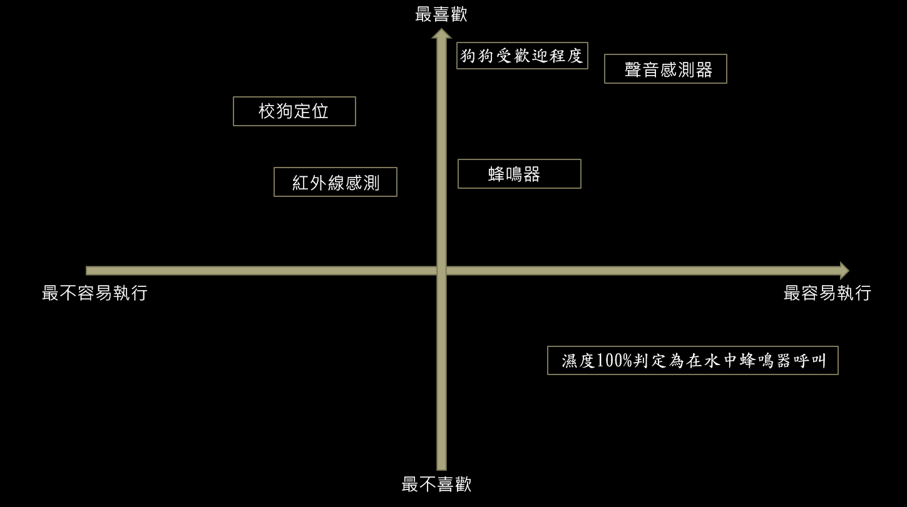
|創意收斂

Slide 6
|市上產品比較
顯示螢幕
狗狗歡迎程度
手機查看定位
蜂鳴器水中呼救
顯示環境溫度與濕度
地圖顯示位置

Slide 7


Slide 8
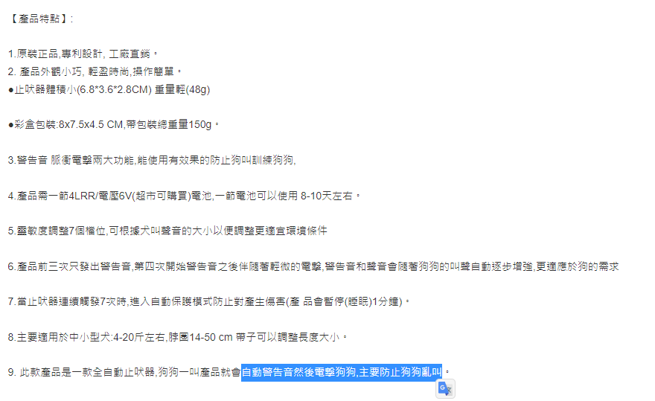

Slide 9
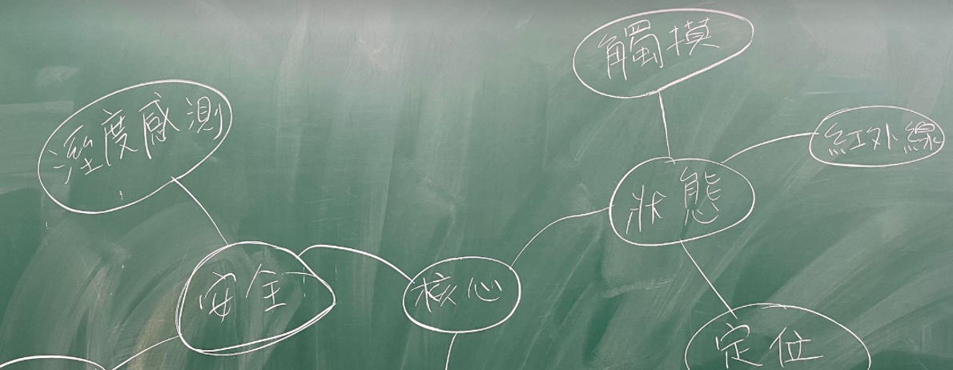
|專題架構圖

Slide 10

專題需求

Slide 11
|周遭配件
蜂鳴器
LCD螢幕
觸摸感測器
溫溼度感測器
NEO-6M GPS模組

Slide 12
|感測器介紹
蜂鳴器
是產生聲音的信號裝置，有機械型、機電型及壓電型。蜂鳴器的典型應用包括警笛、報警裝置、火災警報器、防空警報器、防盜器、定時器等。
LCD螢幕
LCD1602(藍屏白字) 3.3V 1602液晶顯示幕 帶背光

Slide 13
|感測器介紹
觸摸感測器
觸摸傳感器上面的元件，可以感受到物體是否與傳感器是否有接觸。 常態下，觸摸傳感器輸出低電平；當用手指觸碰到觸摸傳感器上的金屬面時，觸摸傳感器輸出高電平。
溫溼度感測器
DHT11溫濕度感測器，濕度測量範圍：20---95%RH，溫度測量範圍：0---50℃。
NEO-6M GPS模組
獲取原始GPS資料。解析原始資料以獲得選定的可讀GPS資訊。
提供NMEA(National Marine Electronics Association) GPS資訊。

Slide 14
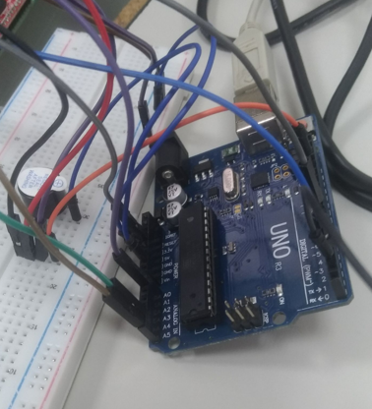
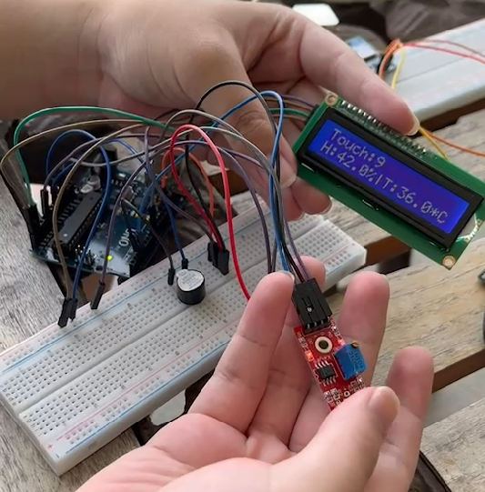
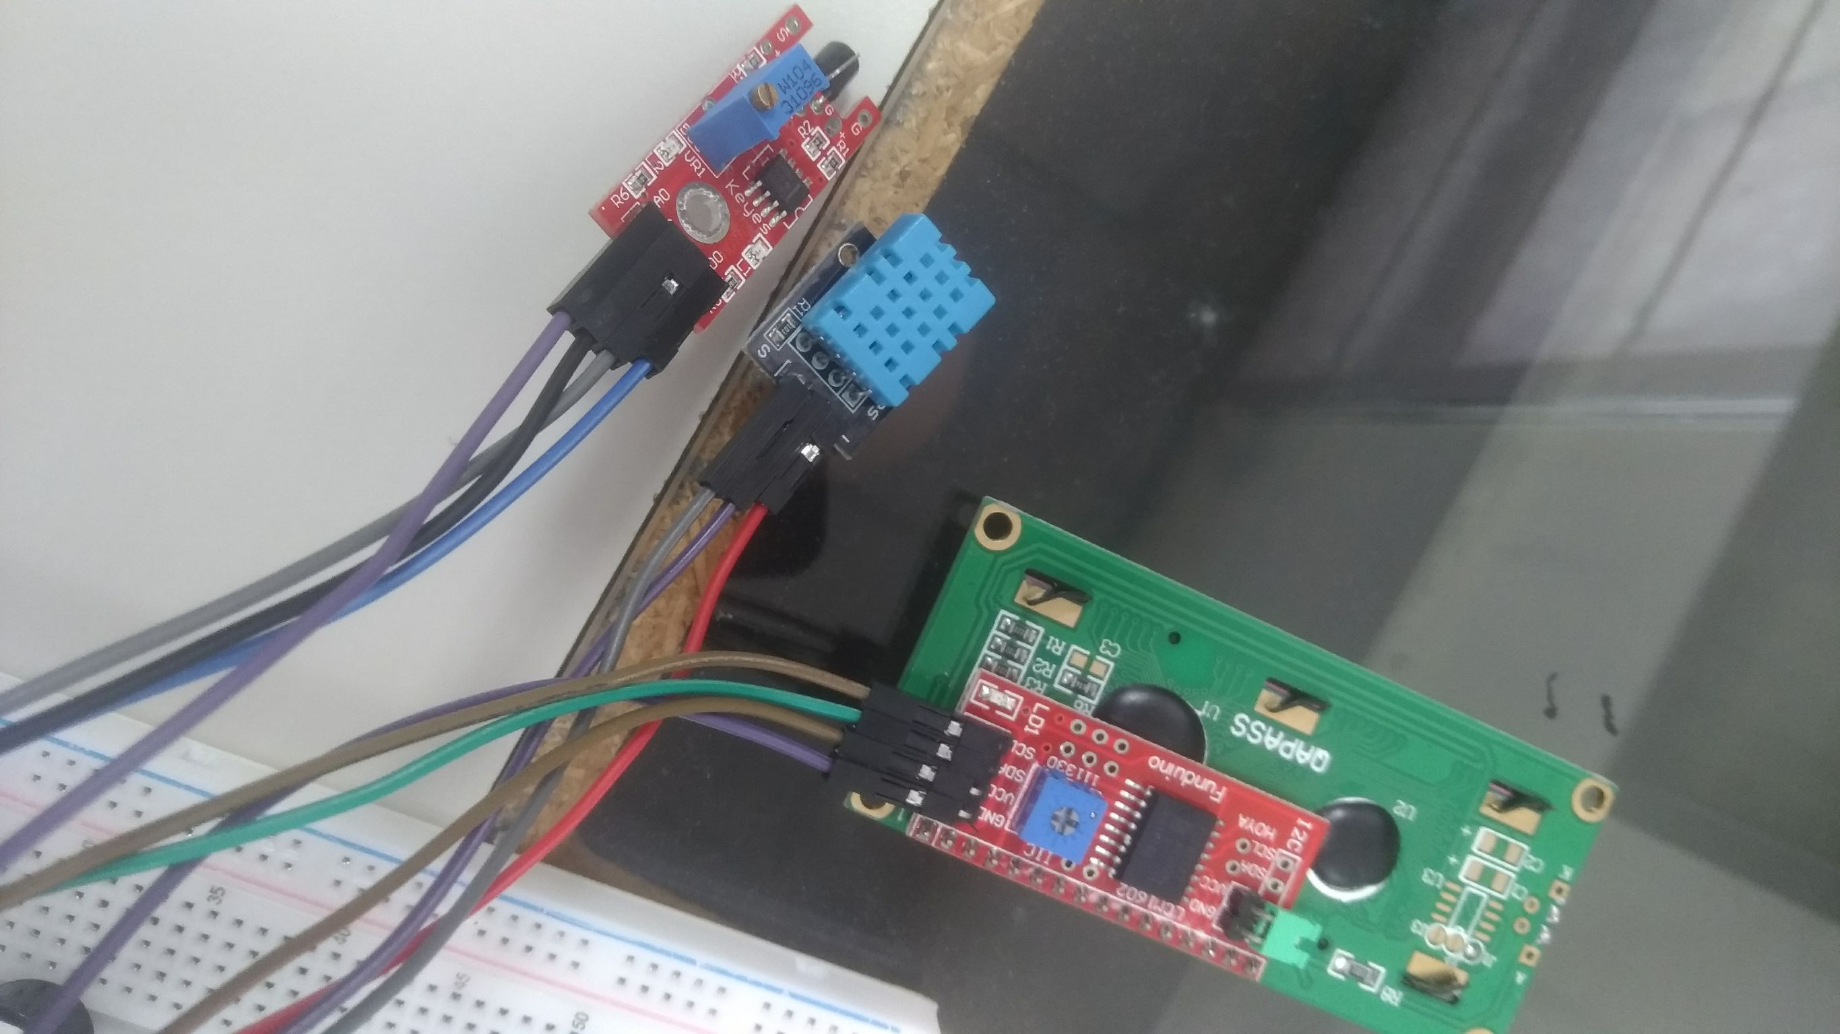
|整體接線方式

Slide 15
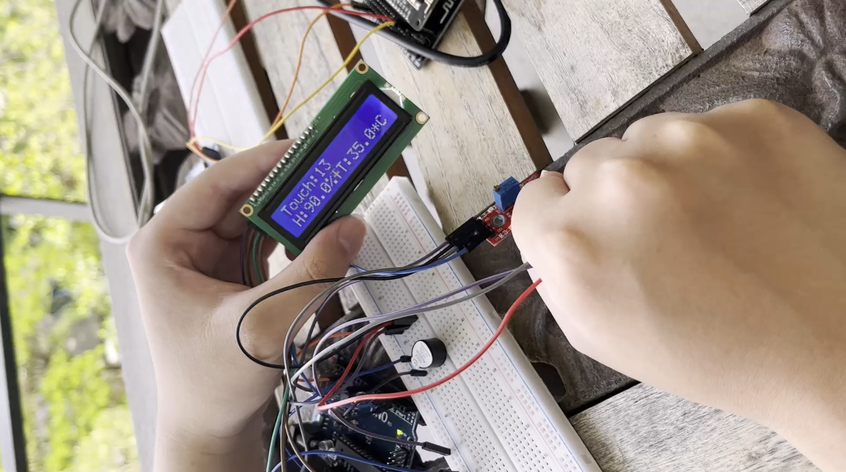
|功能介紹
LCD螢幕顯示：
(上)觸摸感測器計數
(下)濕度|溫度
蜂鳴器：當濕度到達95%呼叫

Slide 16
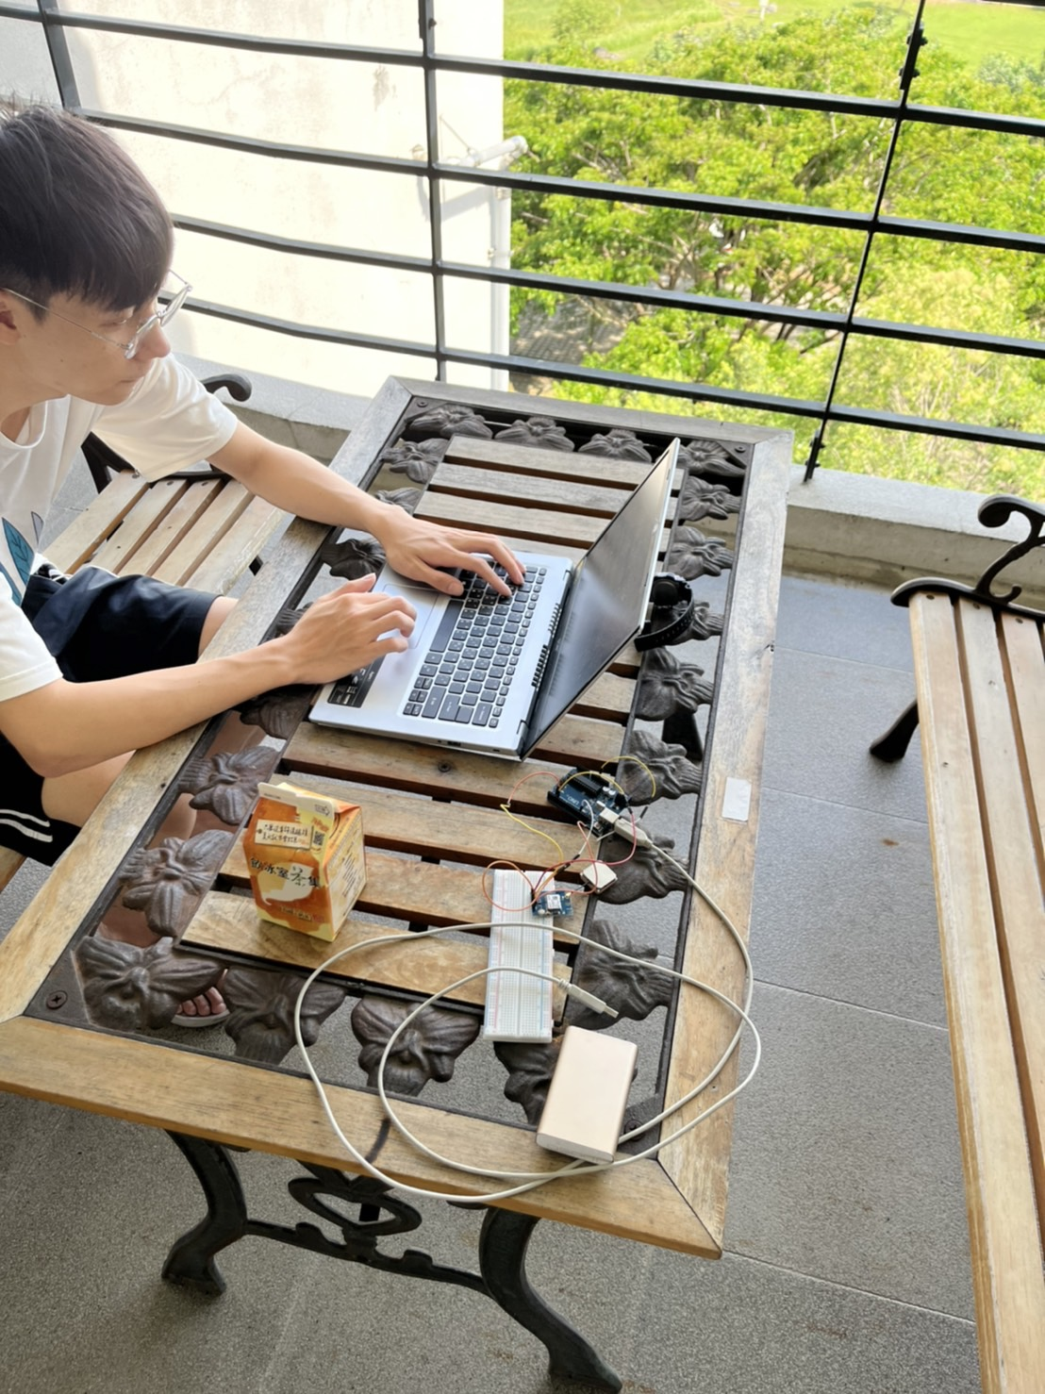
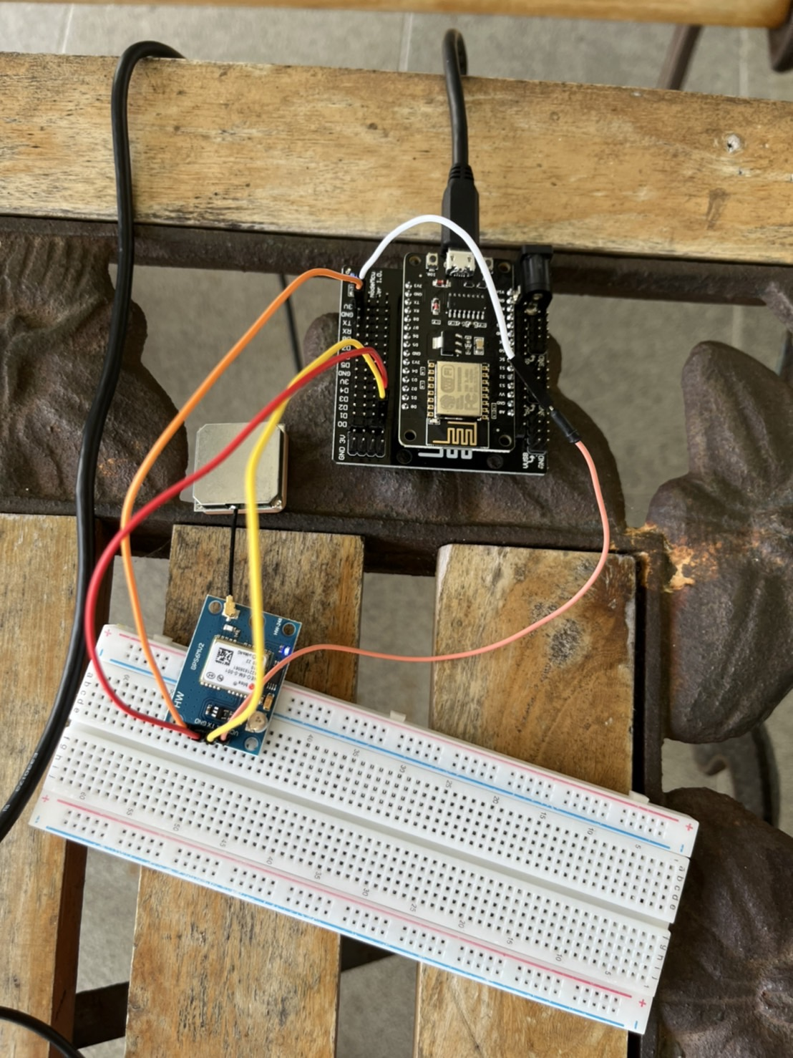
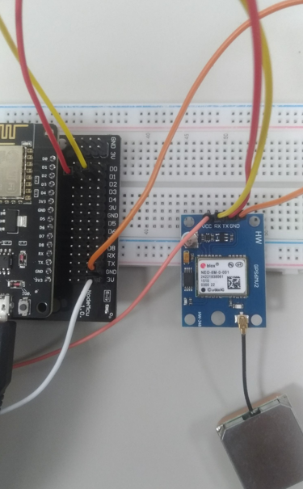
|網路與GPS應用

Slide 17
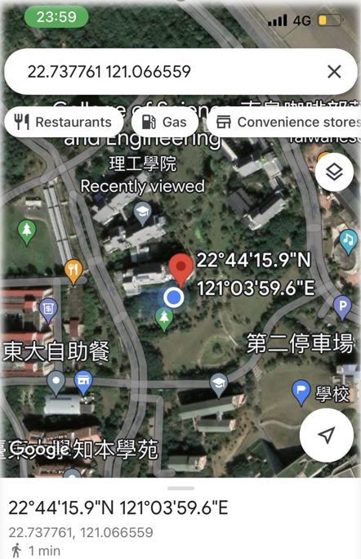
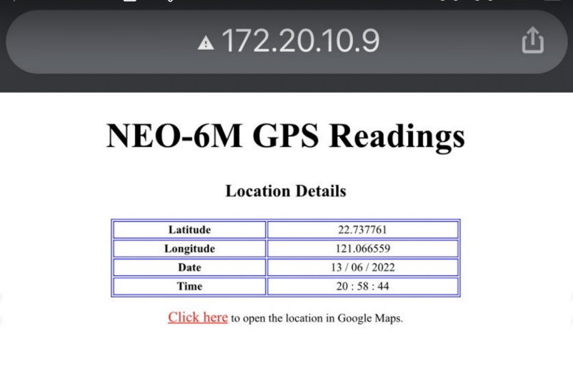
|網路與GPS應用
自己看的到

Slide 18
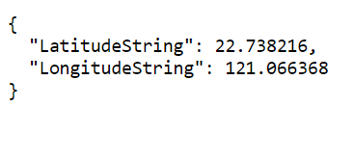
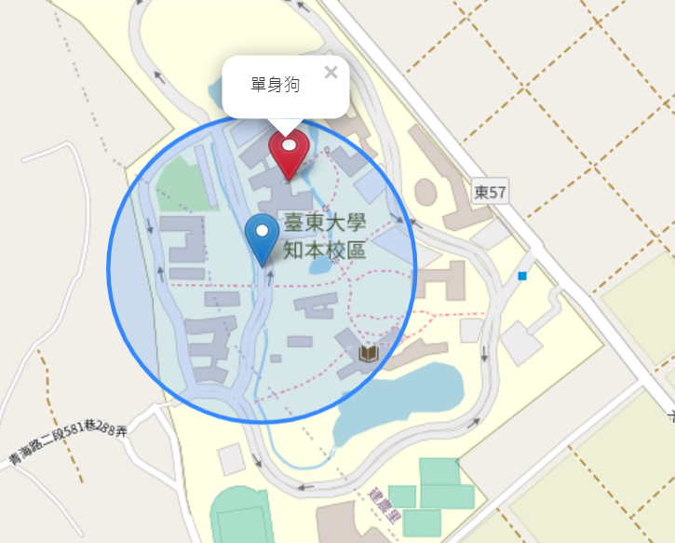
|網路與GPS應用
別人看的到

Slide 19
|網路與GPS應用架構-邊緣運算
NEO-6M GPS
JSON
JavaScript
POST
GET
Git→Heroku
自己看的到
別人看的到

Slide 20
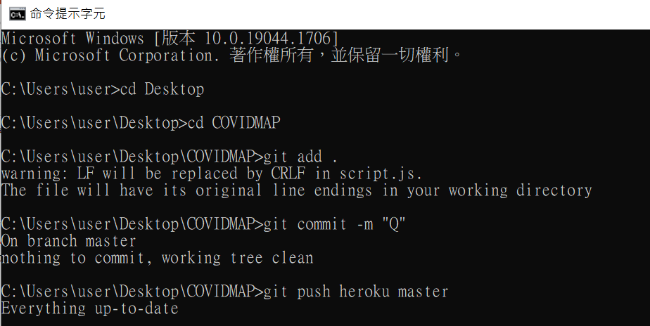
|地圖-GIT

Slide 21
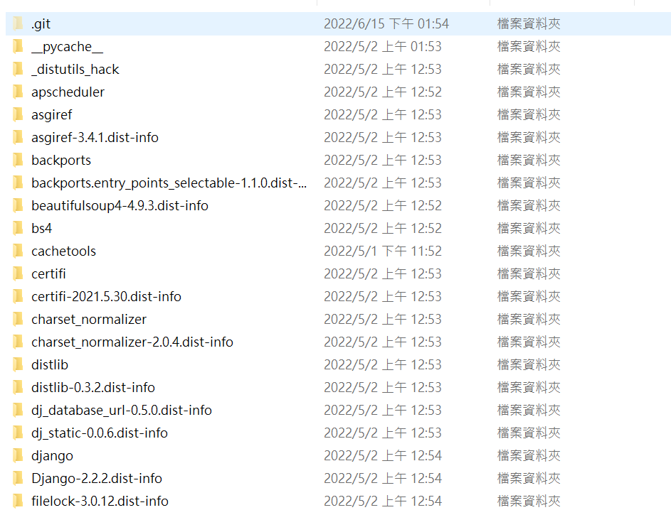
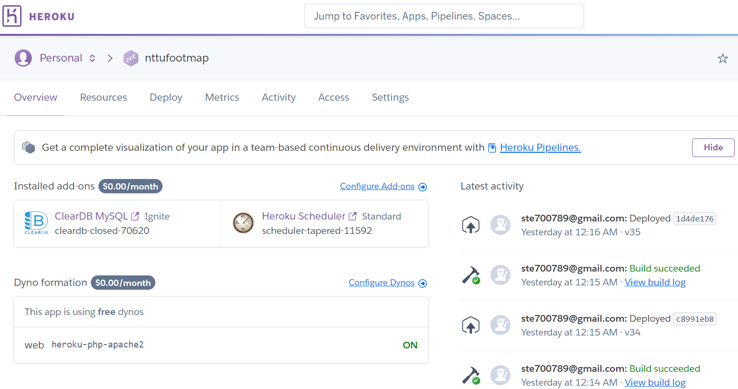
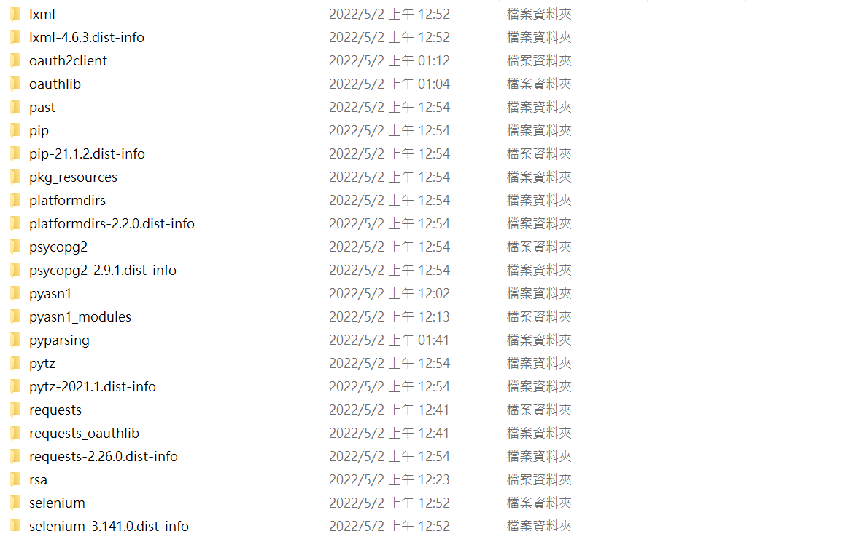
|地圖-Heroku

Slide 22
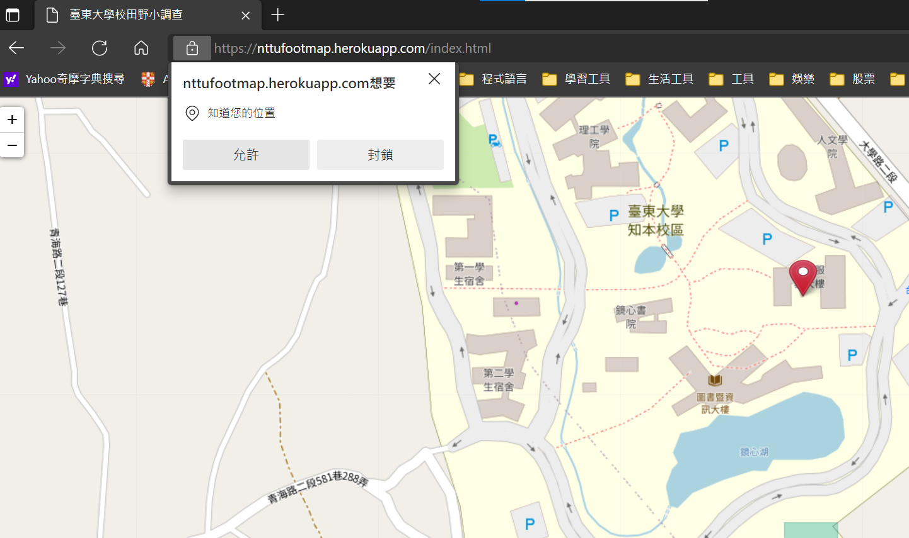
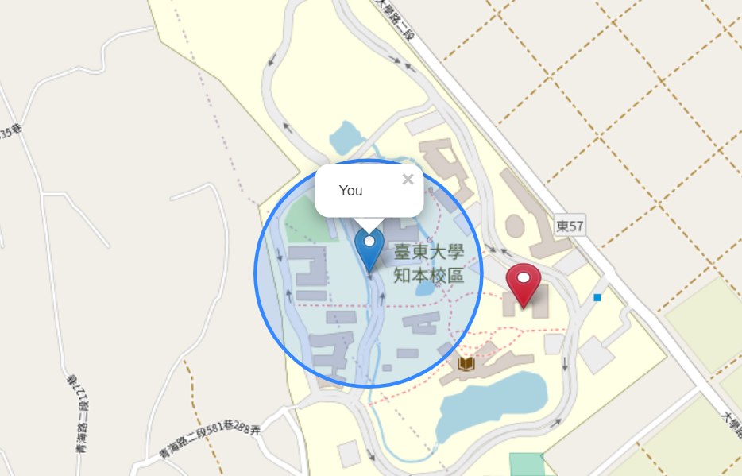

|地圖

Slide 23
|程式碼介紹-UNO
#include <OneWire.h>
#include <DallasTemperature.h>
// Hello friends Welcome to "TECHNO-E-SOLUTION"
// Here is the code for Coffin Song
// output pin is 10, you can change it down in the void setup.
#define NOTE_B0 31
#define NOTE_C1 33
#define NOTE_CS1 35
#define NOTE_D1 37
#define NOTE_DS1 39
#define NOTE_E1 41
#define NOTE_F1 44
#define NOTE_FS1 46
#define NOTE_G1 49
#define NOTE_GS1 52
#define NOTE_A1 55
#define NOTE_AS1 58
#define NOTE_B1 62
#define NOTE_C2 65
#define NOTE_CS2 69
#define NOTE_D2 73
#define NOTE_DS2 78
int Led=13; //設定LED接腳為第13孔
int buttonpin=3;
//int analogPin = 3;
//#define buttonpin 3 //設定觸摸感測器接腳為第3孔
int val; //設定變量val
#include <LiquidCrystal_I2C.h>
#include <Wire.h>
LiquidCrystal_I2C lcd(0x27,16,2); //設定LCD位置0x27,設定LCD大小為16*2
#include "DHT.h"
#define DHTPIN 8
#define DHTTYPE DHT11
//#define DHTTYPE DHT22 // DHT 22 如果用的是DHT22，就用這行
//#define DHTTYPE DHT21 // DHT 21
DHT dht(DHTPIN, DHTTYPE);

Slide 24
|程式碼介紹-UNO
#define NOTE_B3 247
#define NOTE_C4 262
#define NOTE_CS4 277
#define NOTE_D4 294
#define NOTE_DS4 311
#define NOTE_E4 330
#define NOTE_F4 349
#define NOTE_FS4 370
#define NOTE_G4 392
#define NOTE_GS4 415
#define NOTE_A4 440
#define NOTE_AS4 466
#define NOTE_B4 494
#define NOTE_C5 523
#define NOTE_CS5 554
#define NOTE_D5 587
#define NOTE_DS5 622
#define NOTE_E5 659
#define NOTE_F5 698
#define NOTE_FS5 740
#define NOTE_G5 784
#define NOTE_GS5 831
#define NOTE_A5 880
#define NOTE_AS5 932
#define NOTE_E2 82
#define NOTE_F2 87
#define NOTE_FS2 93
#define NOTE_G2 98
#define NOTE_GS2 104
#define NOTE_A2 110
#define NOTE_AS2 117
#define NOTE_B2 123
#define NOTE_C3 131
#define NOTE_CS3 139
#define NOTE_D3 147
#define NOTE_DS3 156
#define NOTE_E3 165
#define NOTE_F3 175
#define NOTE_FS3 185
#define NOTE_G3 196
#define NOTE_GS3 208
#define NOTE_A3 220
#define NOTE_AS3 233

Slide 25
|程式碼介紹-UNO
#define NOTE_FS7 2960
#define NOTE_G7 3136
#define NOTE_GS7 3322
#define NOTE_A7 3520
#define NOTE_AS7 3729
#define NOTE_B7 3951
#define NOTE_C8 4186
#define NOTE_CS8 4435
#define NOTE_D8 4699
#define NOTE_DS8 4978
int melody[] = {
NOTE_AS4, NOTE_AS4, NOTE_AS4, NOTE_AS4,
NOTE_D5, NOTE_D5, NOTE_D5, NOTE_D5,
NOTE_C5, NOTE_C5, NOTE_C5, NOTE_C5,
NOTE_F5, NOTE_F5, NOTE_F5, NOTE_F5,
NOTE_G5, NOTE_G5, NOTE_G5, NOTE_G5,
NOTE_G5, NOTE_G5, NOTE_G5, NOTE_G5,
NOTE_G5, NOTE_G5, NOTE_G5, NOTE_G5,
NOTE_C5, NOTE_AS4, NOTE_A4, NOTE_F4,
NOTE_G4, 0, NOTE_G4, NOTE_D5,
NOTE_C5, 0, NOTE_AS4, 0,
NOTE_A4, 0, NOTE_A4, NOTE_A4,
NOTE_C5, 0, NOTE_AS4, NOTE_A4,
#define NOTE_B5 988
#define NOTE_C6 1047
#define NOTE_CS6 1109
#define NOTE_D6 1175
#define NOTE_DS6 1245
#define NOTE_E6 1319
#define NOTE_F6 1397
#define NOTE_FS6 1480
#define NOTE_G6 1568
#define NOTE_GS6 1661
#define NOTE_A6 1760
#define NOTE_AS6 1865
#define NOTE_B6 1976
#define NOTE_C7 2093
#define NOTE_CS7 2217
#define NOTE_D7 2349
#define NOTE_DS7 2489
#define NOTE_E7 2637
#define NOTE_F7 2794

Slide 26
|程式碼介紹-UNO
int noteDurations[] = {
4,4,4,4,
4,4,4,4,
4,4,4,4,
4,4,4,4,
4,4,4,4,
4,4,4,4,
4,4,4,4,
4,4,4,4,
4,4,4,4,
4,4,4,4,
4,4,4,4,
4,4,4,4,
4,4,4,4,
4,4,4,4,
4,4,4,4,
4,4,4,4,
4,4,4,4,
4,4,4,4,
4,4,4,4,
4,4,4,4,
4,4,4,4,
4,4,4,4,
4,4,4,4,
4,4,4,4,};
NOTE_G4,0, NOTE_G4, NOTE_AS5,
NOTE_A5, NOTE_AS5, NOTE_A5, NOTE_AS5,
NOTE_G4,0, NOTE_G4, NOTE_AS5,
NOTE_A5, NOTE_AS5, NOTE_A5, NOTE_AS5,
NOTE_G4, 0, NOTE_G4, NOTE_D5,
NOTE_C5, 0, NOTE_AS4, 0,
NOTE_A4, 0, NOTE_A4, NOTE_A4,
NOTE_C5, 0, NOTE_AS4, NOTE_A4,
NOTE_G4,0, NOTE_G4, NOTE_AS5,
NOTE_A5, NOTE_AS5, NOTE_A5, NOTE_AS5,
NOTE_G4,0, NOTE_G4, NOTE_AS5,
NOTE_A5, NOTE_AS5, NOTE_A5, NOTE_AS5
};

Slide 27
|程式碼介紹-UNO
void loop(){
count++;
float hum = dht.readHumidity(); //取得濕度
float tem = dht.readTemperature(); //取得溫度C
lcd.setCursor(0, 1);
lcd.print("H:");
lcd.print(hum);
lcd.setCursor(6, 1);
lcd.print("%\t");
if (count % 2) {
lcd.setCursor(7, 1);
lcd.print("|");
}
else {
lcd.setCursor(7, 1);
lcd.print("-");
}
void setup(){
pinMode(Led,OUTPUT); //設定LED為输出
pinMode( buttonpin,INPUT); //設定感測器為输入
Serial.begin(9600);
lcd.init(); //初始化LCD
lcd.backlight(); //開啟背光
lcd.print("Touch:0");
//lcd.print("
Serial.println("DHTxx test!");
dht.begin(); //初始化DHT
}
int sum=0;
int count=-1;
位置

Slide 28
|程式碼介紹-UNO
// lcd.setCursor(7,1);
// lcd.print(" ");
lcd.setCursor(8, 1);
lcd.print("T:");
lcd.print(tem);
lcd.setCursor(14, 1);
lcd.print("*C");
//顯示在監控視窗裡
Serial.print("Humidity: ");
Serial.print(hum);
Serial.print(" %\t");
Serial.print("Temperature: ");
Serial.print(tem);
Serial.println(" *C ");
val=digitalRead(buttonpin); //將感測器的讀值傳给val
if(val==HIGH){
sum++;
digitalWrite(Led,HIGH);
//val = analogRead(analogPin);
//analogWrite(Led,HIGH);
Serial.println(sum);
lcd.setCursor(0,0);
lcd.print("Touch:");
lcd.print(sum);
delay(100);
}
else{
digitalWrite(Led,LOW);
}

Slide 29
|程式碼介紹-UNO
if(hum>=95){
for (int thisNote = 0; thisNote < 92; thisNote++)
{
int noteDuration = 750 / noteDurations[thisNote];
tone(2, melody[thisNote], noteDuration);
int pauseBetweenNotes = noteDuration * 1.30;
delay(pauseBetweenNotes);
noTone(2);}
}
}

Slide 30
|程式碼介紹-ESP8266
#include <TinyGPS++.h>
#include <SoftwareSerial.h>
#include <ESP8266WiFi.h>
#include <WiFiClient.h>
#include <ESP8266HTTPClient.h>
#include <ArduinoJson.h>
TinyGPSPlus gps;
SoftwareSerial SerialGPS(4, 5);
const char* ssid = "少時不讀書長大工程師";
const char* password = "12301230";
float Latitude , Longitude;
int year , month , date, hour , minute , second;
String DateString , TimeString , LatitudeString , LongitudeString;
WiFiServer server(80);
// Domain Name with full URL Path for HTTP POST Request
const char* serverName = "http://jsonbin.org/smalllidinosaur/nttufootmap";
unsigned long last_time = 0;
unsigned long timer_delay = 10000;

Slide 31
|程式碼介紹-ESP8266
void loop(){
while (SerialGPS.available() > 0)
if (gps.encode(SerialGPS.read())){
if (gps.location.isValid())
{
Latitude = gps.location.lat();
LatitudeString = String(Latitude , 6);
Longitude = gps.location.lng();
LongitudeString = String(Longitude , 6);
HTTPClient http;
http.begin(serverName);
http.addHeader("Content-Type", "application/x-www-form-urlencoded");
http.addHeader(“Authorization”, “密碼");
// Data to send with HTTP POST
String httpRequestData = "{\"LatitudeString\":"+LatitudeString+",\"LongitudeString\":"+ LongitudeString+"}";
// Send HTTP POST request
int httpResponseCode = http.POST(httpRequestData);
http.end();
}
void setup()
{
Serial.begin(9600);
SerialGPS.begin(9600);
Serial.println();
Serial.print("Connecting");
WiFi.begin(ssid, password);
while (WiFi.status() != WL_CONNECTED)
{
delay(500);
Serial.print(".");
}
Serial.println("");
Serial.println("WiFi connected");
server.begin();
Serial.println("Server started");
Serial.println(WiFi.localIP());
}
POST

Slide 32
|程式碼介紹-ESP8266
if (gps.date.isValid()){
DateString = "";
date = gps.date.day();
month = gps.date.month();
year = gps.date.year();
if (date < 10)
DateString = '0';
DateString += String(date);
DateString += " / ";
if (month < 10)
DateString += '0';
DateString += String(month);
DateString += " / ";
if (year < 10)
DateString += '0';
DateString += String(year);
}
if (gps.time.isValid() {
TimeString = "";
hour = gps.time.hour()+ 5; //adjust UTC
minute = gps.time.minute();
second = gps.time.second();
if (hour < 10)
TimeString = '0';
TimeString += String(hour);
TimeString += " : ";
if (minute < 10)
TimeString += '0';
TimeString += String(minute);
TimeString += " : ";
if (second < 10)
TimeString += '0';
TimeString += String(second);
}

Slide 33
|程式碼介紹-ESP8266
//Response
String s = "HTTP/1.1 200 OK\r\nContent-Type: text/html\r\n\r\n <!DOCTYPE html> <html> <head> <title>NEO-6M GPS Readings</title> <style>";
s += "table, th, td {border: 1px solid blue;} </style> </head> <body> <h1 style=";
s += "font-size:300%;";
s += " ALIGN=CENTER>NEO-6M GPS Readings</h1>";
s += "<p ALIGN=CENTER style=""font-size:150%;""";
s += "> <b>Location Details</b></p> <table ALIGN=CENTER style=";
s += "width:50%";
s += "> <tr> <th>Latitude</th>";
s += "<td ALIGN=CENTER >";
s += LatitudeString;
s += "</td> </tr> <tr> <th>Longitude</th> <td ALIGN=CENTER >";
s += LongitudeString;
s += "</td> </tr> <tr> <th>Date</th> <td ALIGN=CENTER >";
s += DateString;
s += "</td></tr> <tr> <th>Time</th> <td ALIGN=CENTER >";
s += TimeString;
s += "</td> </tr> </table> ";
}
WiFiClient client = server.available();
if (!client)
{
return;
}

Slide 34
|程式碼介紹-ESP8266
if (gps.location.isValid())
{
s += "<p align=center><a style=""color:RED;font-size:125%;"" href=""http://maps.google.com/maps?&z=15&mrt=yp&t=k&q=";
s += LatitudeString;
s += "+";
s += LongitudeString;
s += """ target=""_top"">Click here</a> to open the location in Google Maps.</p>";
}
s += "</body> </html> \n";
client.print(s);
delay(100);
}

Slide 35

QA

